Slide 1

SMART GRIDS CASE STUDY 6
Optimization of PV-Heat Pump-Thermal Storage System
Uthman Oyebanji
Krishna Prasad Timilsina
Samrat Pathak
Abdullah Barlas Sirin

Slide 2
PV-Heat Pump-Thermal Storage System
Optimal operation of the system based on two strategies:
Minimization of operation cost: Electricity price 25 cent/kWh, FIT 10 cent/kWh
Minimizing the annual net consumption from the grid so as to minimize grid peak

Slide 3
System Schematics
Grid
Heat pump
Electrical load
Boiler
Thermal storage
Heating load
Electrical power
Thermal power

Slide 4
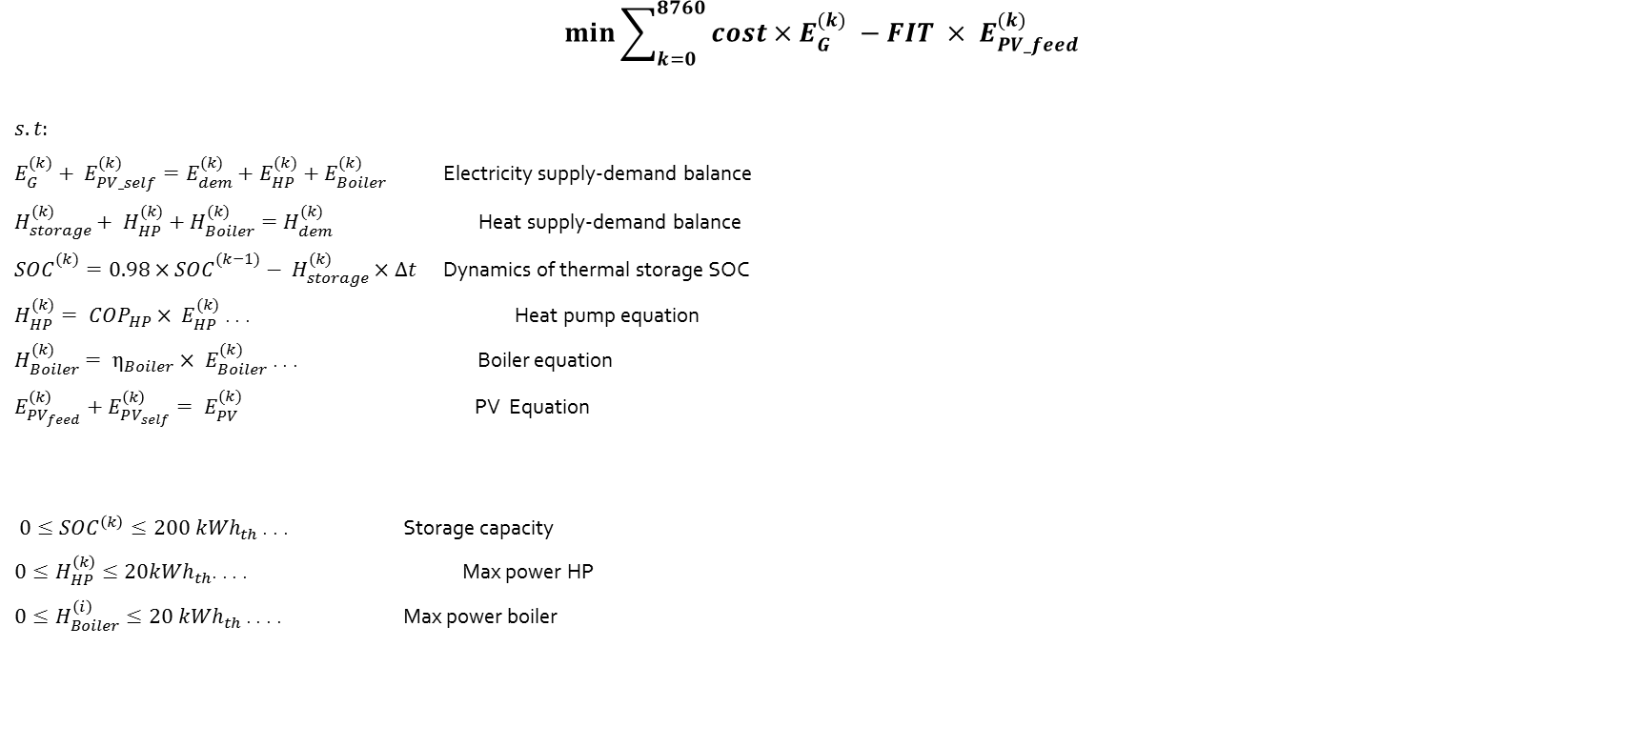
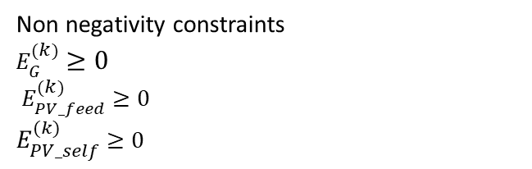
Strategy 1: Minimize Self - Operation cost
$$\min{\sum_{k=0}^{8760}{{cost×E}_{G}^{(k)}}} −FIT × E_{PV_feed}^{(k)}$$
$$s.t:$$
$E_{G}^{(k)}+ E_{PV_self}^{(k)}=E_{dem}^{(k)}+E_{HP}^{(k)}+E_{Boiler}^{(k)}$ Electricity supply-demand balance
$H_{storage}^{(k)}+ H_{HP}^{(k)}+H_{Boiler}^{(k)}=H_{dem}^{(k)}$ Heat supply-demand balance
${SOC}_{}^{(k)}={0.98×SOC}_{}^{(k−1)}− H_{storage}^{(k)}×∆t$ Dynamics of thermal storage SOC
$H_{HP}^{(k)}= {COP}_{HP}× E_{HP}^{(k)}$ . . . Heat pump equation
$H_{Boiler}^{(k)}= η_{Boiler}× E_{Boiler}^{(k)}$ . . . Boiler equation
$E_{PV_{feed}}^{\left(k\right)}+E_{PV_{self}}^{\left(k\right)}= E_{PV}^{(k)}$ PV Equation
$0≤{SOC}^{\left(k\right)}≤200 {kWh}_{th}$ . . . Storage capacity
$0≤H_{HP}^{\left(k\right)}≤20{kWh}_{th}$. . . . Max power HP
$0≤H_{Boiler}^{\left(i\right)}≤20 {kWh}_{th}$ . . . . Max power boiler
Non negativity constraints
$E_{G}^{(k)}$ $≥0$
$E_{PV_feed}^{(k)}$ $≥0$
$E_{PV_self}^{(k)}$ $≥0$

Slide 5
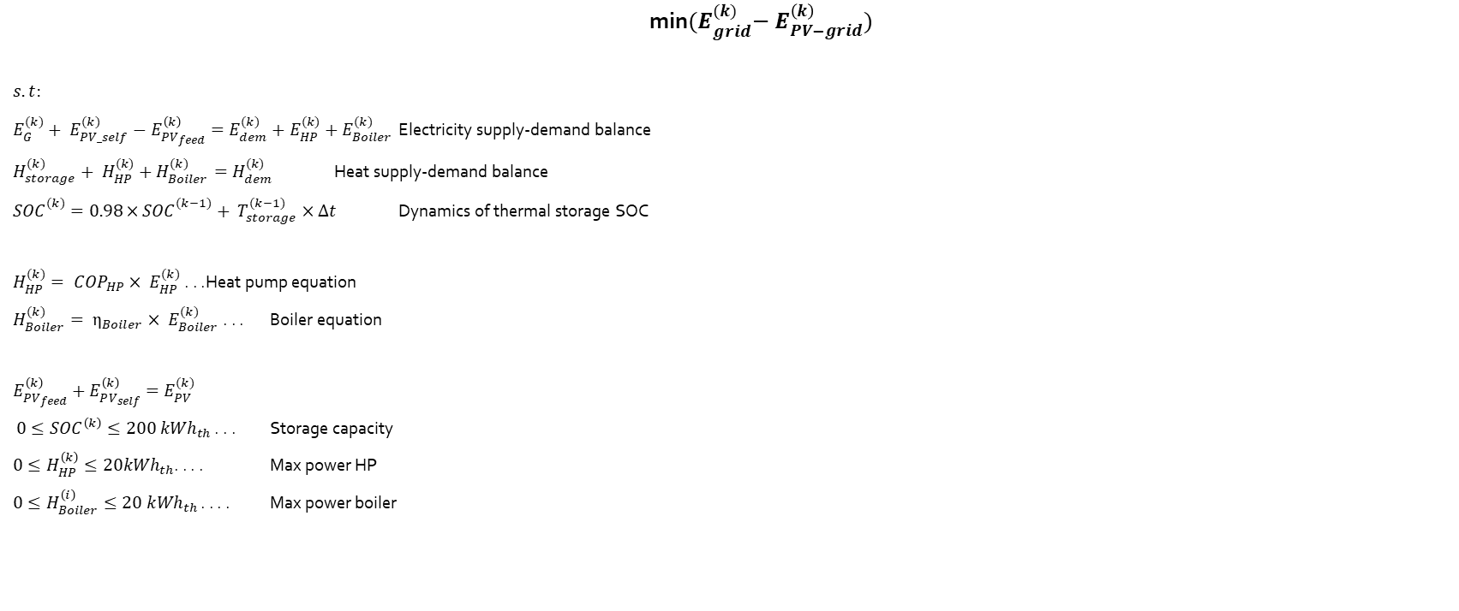
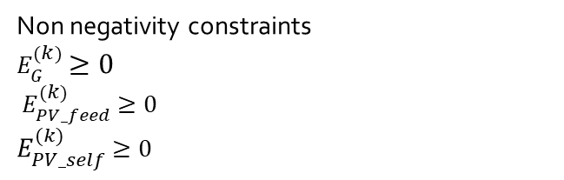
Strategy 2: Minimize the maximum net grid consumption
min${(E}_{grid}^{(k)}− E_{PV−grid}^{\left(k\right)})$
$$s.t:$$
$E_{G}^{(k)}+ E_{PV_self}^{(k)}−E_{PV_{feed}}^{\left(k\right)}=E_{dem}^{(k)}+E_{HP}^{(k)}+E_{Boiler}^{(k)}$ Electricity supply-demand balance
$H_{storage}^{(k)}+ H_{HP}^{(k)}+H_{Boiler}^{(k)}=H_{dem}^{(k)}$ Heat supply-demand balance
${SOC}_{}^{(k)}={0.98×SOC}_{}^{(k−1)}+ T_{storage}^{(k−1)}×∆t$ Dynamics of thermal storage SOC
$H_{HP}^{(k)}= {COP}_{HP}× E_{HP}^{(k)}$ . . . Heat pump equation
$H_{Boiler}^{(k)}= η_{Boiler}× E_{Boiler}^{(k)}$ . . . Boiler equation
$E_{PV_{feed}}^{\left(k\right)}+E_{PV_{self}}^{\left(k\right)}=E_{PV}^{(k)}$
$0≤{SOC}^{\left(k\right)}≤200 {kWh}_{th}$ . . . Storage capacity
$0≤H_{HP}^{\left(k\right)}≤20{kWh}_{th}$. . . . Max power HP
$0≤H_{Boiler}^{\left(i\right)}≤20 {kWh}_{th}$ . . . . Max power boiler
Non negativity constraints
$E_{G}^{(k)}$ $≥0$
$E_{PV_feed}^{(k)}$ $≥0$
$E_{PV_self}^{(k)}$ $≥0$

Slide 6
Strategy 2
Reducing the load by making the maximum use of the PV generation within the system rather than feeding it to grid
No usage of boiler in the second strategy 2.
Heat pump supplies all the heat load in strategy 2

Slide 7
COMPARISON OF GRID PEAK
The peak in Strategy 2 is reduced
Due to the usage of PV within the system

Slide 8
COST ANALYSIS
The operation cost has reduced in the second strategy
The reduction of operation costs gives more profit
Higher opportunity cost of using the Boiler from grid electricity and from PV generation
Very low opportunity cost of using the Heat Pump due to higher generation efficiency

Slide 9
PV Generation vs Grid Electricity: Strategy 1
POWER (KW)
HOURS

Slide 10
PV Generation vs Grid Electricity: Strategy 1
POWER (KW)
HOURS

Slide 11
Duration Curves for Grid Peak

Slide 12
COST ANALYSIS
The operation cost has reduced in the second strategy
The reduction of operation costs gives more profit
Higher opportunity cost of using the Boiler from grid electricity and from PV generation
Very low opportunity cost of using the Heat Pump due to higher generation efficiency

Slide 13
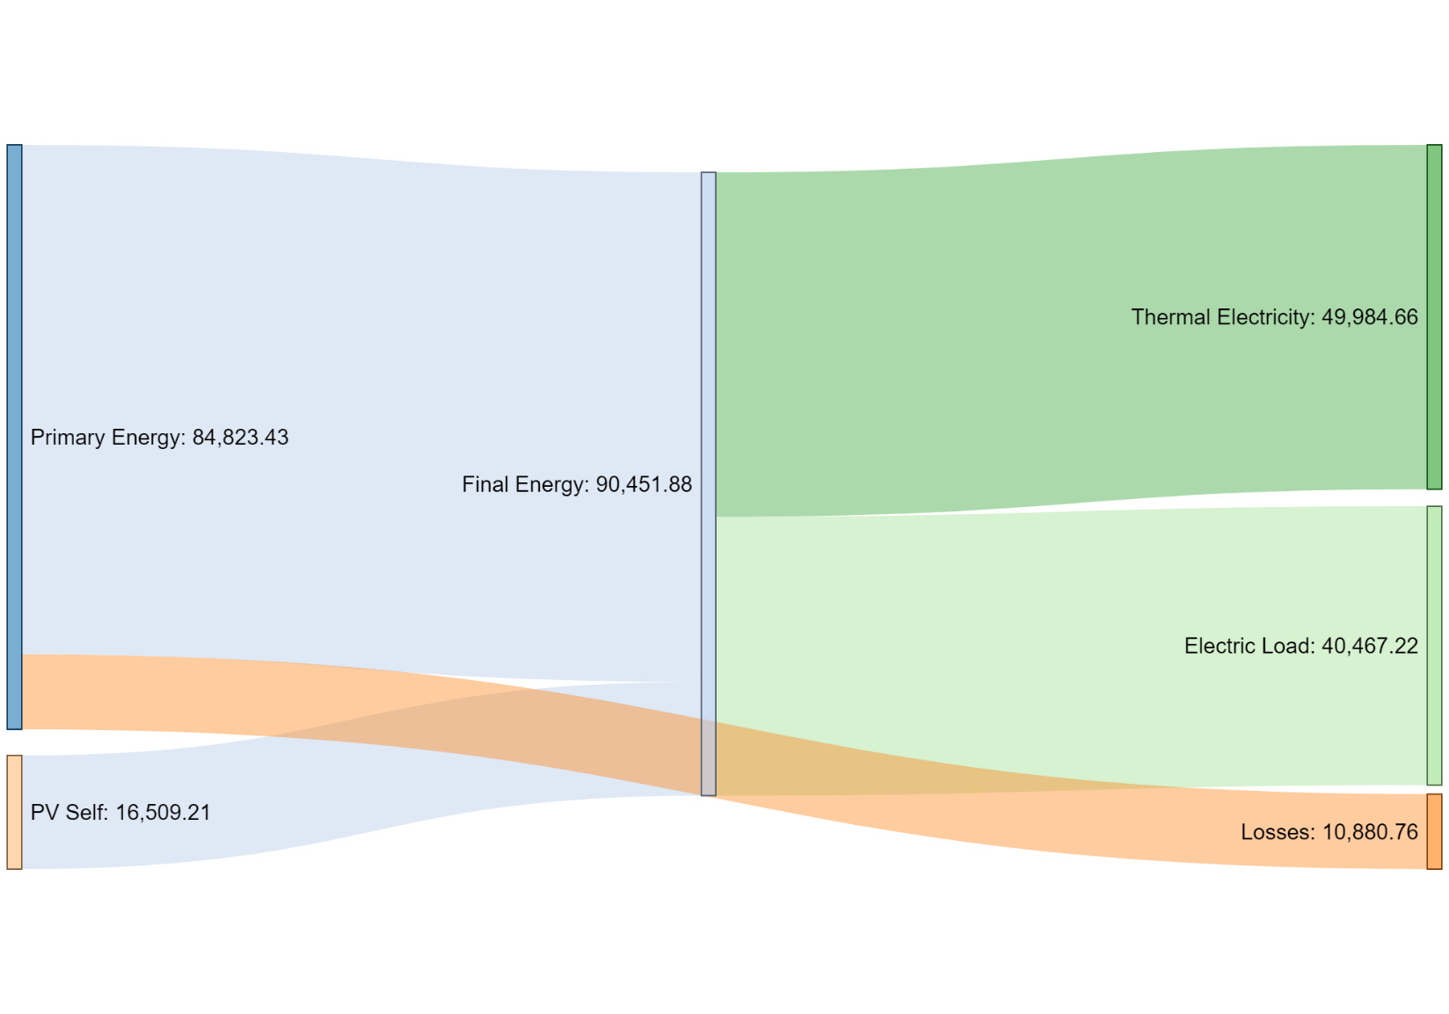
Energy Flow Sankey Diagram for Operation Cost Minimization Strategy
Lower Usage of Storage
Lower Usage of Thermal Electricity
Higher Feed to the Grid
Higher Primary Energy Consumption

Slide 14
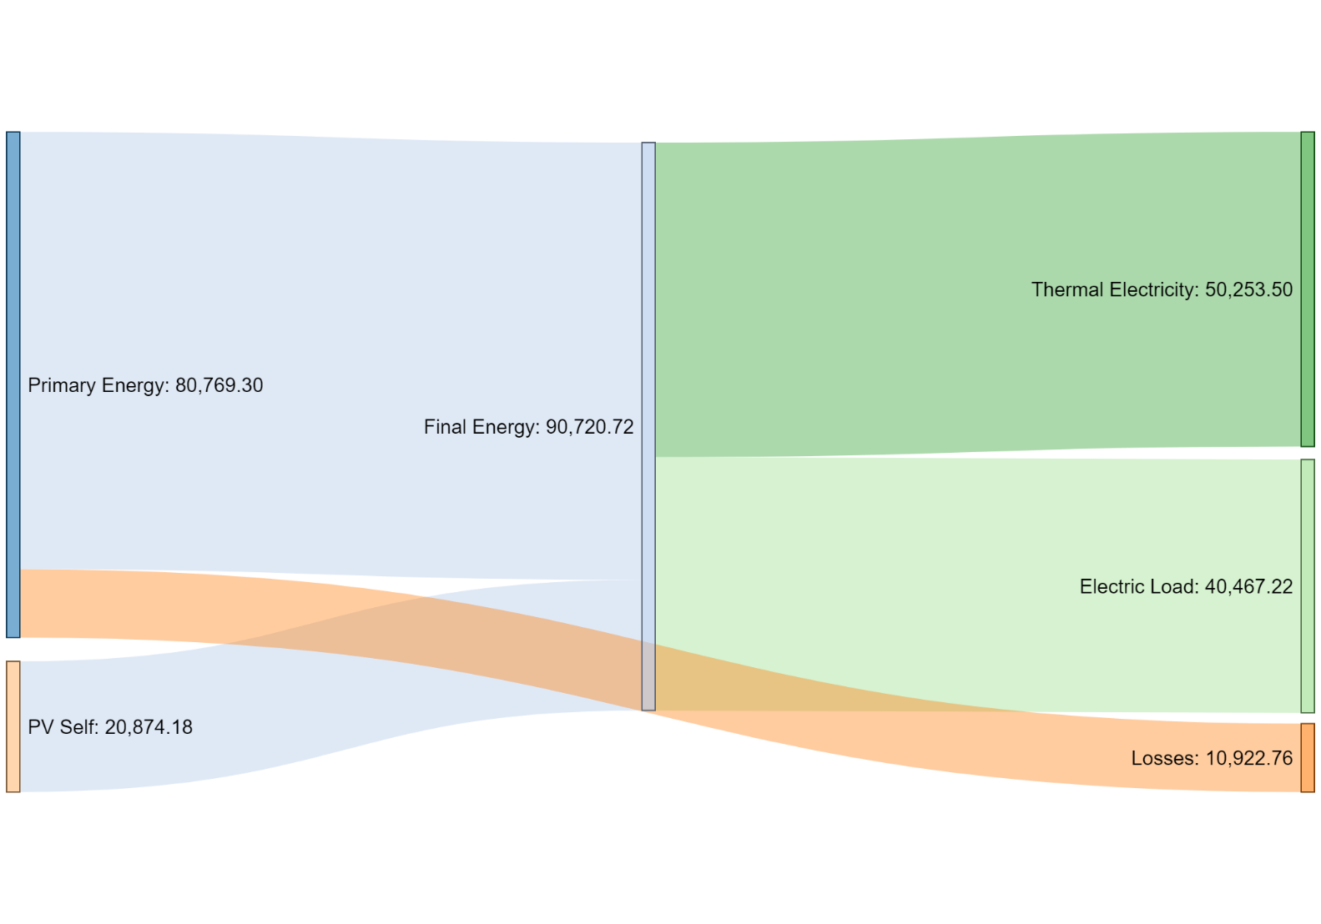
Energy Flow Sankey Diagram for Grid Peak Minimization Strategy
Higher Usage of Storage
Higher Usage of Thermal Electricity
Lower Feed to the Grid
Lower Primary Energy Consumption

Slide 15
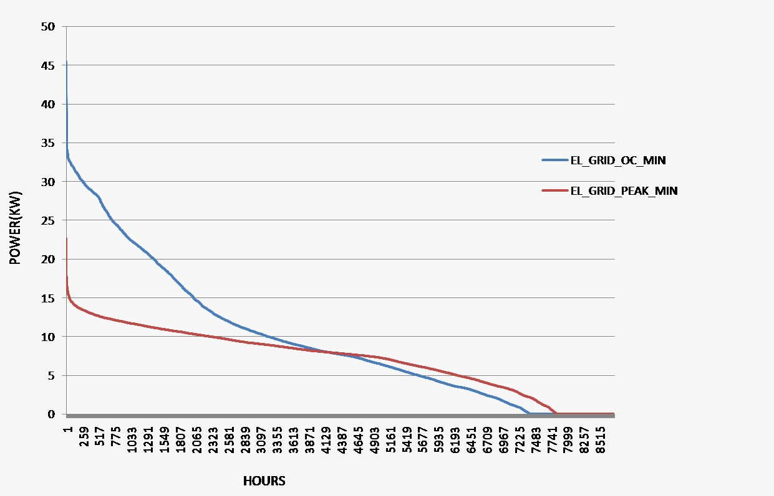
Effect of the reduced peak power on the electricity network
Strategy 2, which reduces the grid peak, leads to load shifting. Electricity usage from the grid are scheduled to off-peak periods

Slide 16
Discussion of topics; voltage, current and losses
Voltage used for the flow of current in the electricity grid
High voltage at transmission level to transmit current at reduced losses.
Voltage drop control/balance is always sought after which Strategy 2 can provide shedding off the peak.

Slide 17
Conclusion
The strategies make higher use of heat pump for heating due to cost effectiveness. This is because of higher conversion efficiency of the heat pump by 300% (COP of 3).
Grid peak minimization can lead to cheaper renumeration on electric price due to reducing electricity usage in peak period to enable scheduling in off-peak.
The system was modelled (and run in python puLP) to obtain global solution. We believe a change of method of solution to MPC will definitely improve the results.

Slide 18
THANK YOU
We welcome your suggestions, contributions and questions

